Slide 1
Diff eq pt 2 ch 4

Slide 2
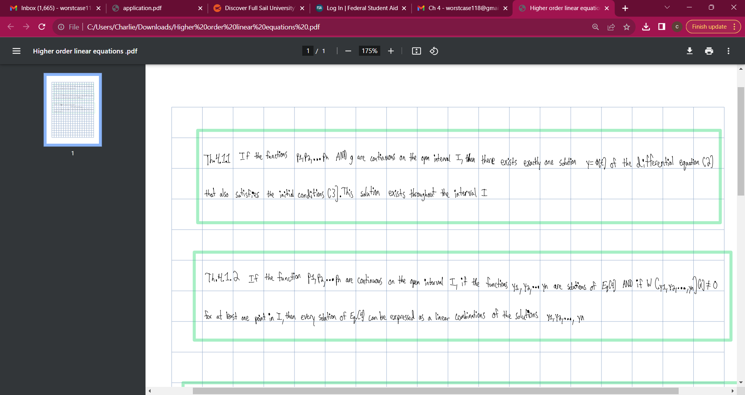

Slide 3
